Slide 1
Threading
Nikolay Pavlov

Slide 2
Synchronization

Slide 3
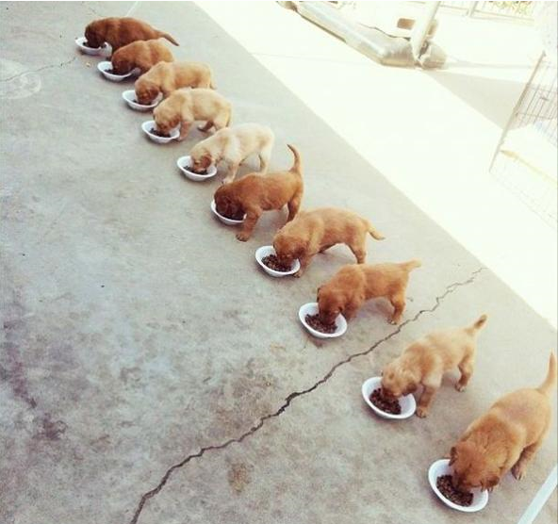
Parallel Programming in Theory

Slide 4
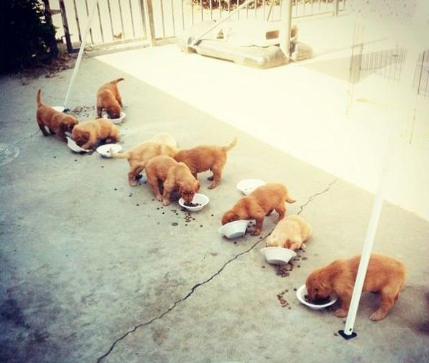
Parallel Programming in Reality

Slide 5
Why Do We Need Synchronization
Coordinate the actions of threads for a predictable outcome
Required when threads access the same data
Especially when writing is involved

Slide 6
Demo

Slide 7
Types of Synchronization
Blocking
Waits for another thread to finish: Thread.Join, Task.Wait
Locking
Limits the number of threads that execute a section of code at a time
Exclusive – only one thread is allowed
Non-exclusive – multiple threads are allowed
Signaling
Wait until receiving a notification from another thread
Non-blocking
Hardware-supported atomic operations

Slide 8

Locking

Slide 9
Locking
C# lock keyword
Only one thread can acquire the lock
Monitor
Same as lock
Mutex
Same as monitor, but can be shared across processes / applications
Slower than lock
Semaphore
Multiple threads can acquire the lock
Reader-writer locks
Many can read, only one can write

Slide 10
When to Lock
Always when accessing a writable, shared field
When atomicity is required:
Atomicity – perform a group of actions as one
Even simple operations require locking
data = data + 1 can actually be complied down to:
mov eax, [data]; add eax, 1; mov [data], eax

Slide 11
Locking Demo

Slide 12
Dangers of Locking
Lock too little
Atomicity and safety are not achieved
Lock too much
Reduces efficiency
Deadlocks
Application is dead

Slide 13
Locking Demo

Slide 14
Signaling
One or multiple threads wait until they receive notification from another
Imagine a door, or a cross-light
Usually used to coordinate execution
Have common name: event wait handlers

Slide 15
Signaling Constructs
AutoResetEvent
Allows only one thread to continue
Other threads will still wait
Order is not guaranteed
ManualResetEvent
Any number of threads will continue
Have to call Reset to “close”
CountdownEvent
Waits for more than one thread

Slide 16
Signaling, continued
CountdownEvent
Waits for more than one thread
Semaphore
Controls access to a limited resource
Only a selected number of threads can acquire the resource, the others wait

Slide 17
Signaling, continued
You can wait on multiple event handlers
WaitHandle.WaitAny
WaitHandle.WaitAll
Barrier
Allows many threads to all wait at a single point
Can also do something before releasing the threads

Slide 18
Demos
ManualResetEvent
Semaphore
CountdownEvent

Slide 19
The World of Tasks
ContinueWith
WhenAll
WhenAny

